Slide 1
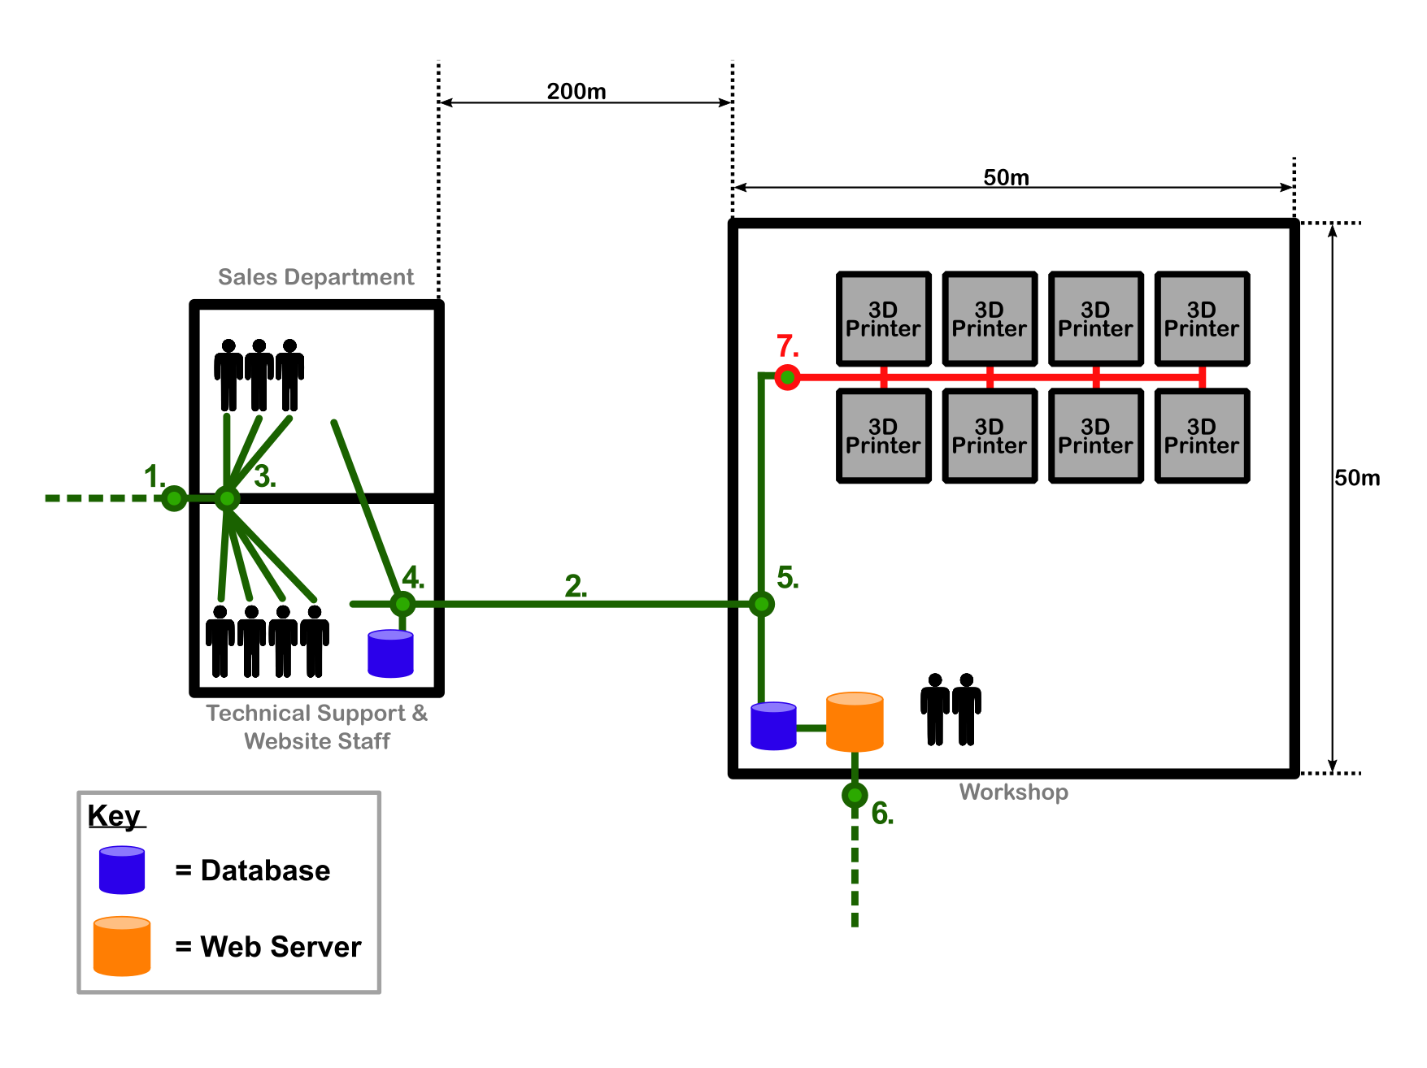
Point 7
Point 7 manages the connection of the 3D Printer network and its connection to business network.
Main Considerations are connection speed, reliability, security and cost.
Majority of 3D printer technologies (FDM, SLA) connect via USB or Wi-fi.

Slide 2
Possible Solutions
Wired
USB Hub
USB Switch
Automatic Printer Switch (Ethernet)
USB to Ethernet Adapter
Ethernet Network Switch
Wireless
Router
Hub
Repeater

Slide 3
Advantages
Wired Connection is much more secure and reliable.
Wired networks offer more speed than wireless.
Easier mobility of network and devices with Wireless.
USB to Ethernet adapter data rates as fast as 1000Mbps.
Disadvantages
Installing a physical link of USB and hub is more costly than a wireless setup
More cables around the warehouse for wired connection increases risk hazards in the work place.
Specifically designed printer network switches require an Ethernet connection.
USB to Ethernet adapter is more cable and expense.

Slide 4
Proposed Solution
The 3D printers will be connected to the console with a physical network of USB cabling to a Hub.
Hubs and USB cabling compatible with USB 2.0/3.0.
Main use of the network is via USB.
Suggest that a Wi-Fi router be installed as a back up system in the event that there are issues USB connection. Cheap and easy to install.

